Slide 1
DSN Commnunity Certificate Issuer

Slide 2
Problem with the Old
DSNAI0010500
https://cert.datasciencenigeria.ai/

Slide 3
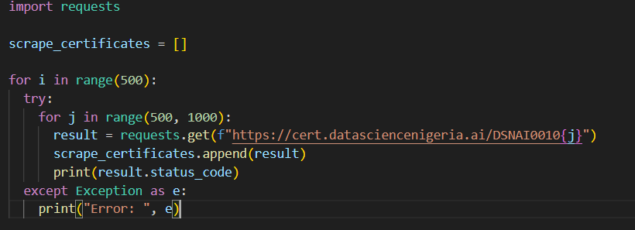
Problem with the Old

Slide 4
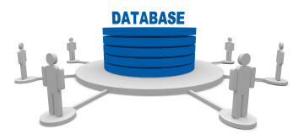
What does that mean?
Access to Database
Platform Insecurity

Slide 5

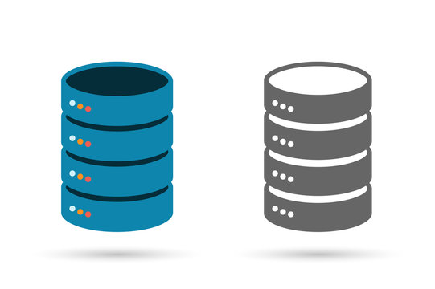
Improvement of the New
3 Layer Details
DSNAI0009543
{ Certificate ID }
https://illustrious-frangollo-3791ca.netlify.app/
ken99@yahoo.com
{ Email }
John Doe
{ Name }

Slide 6
Demo
https://illustrious-frangollo-3791ca.netlify.app
Students
Admin
https://illustrious-frangollo-3791ca.netlify.app/login

